Slide 1













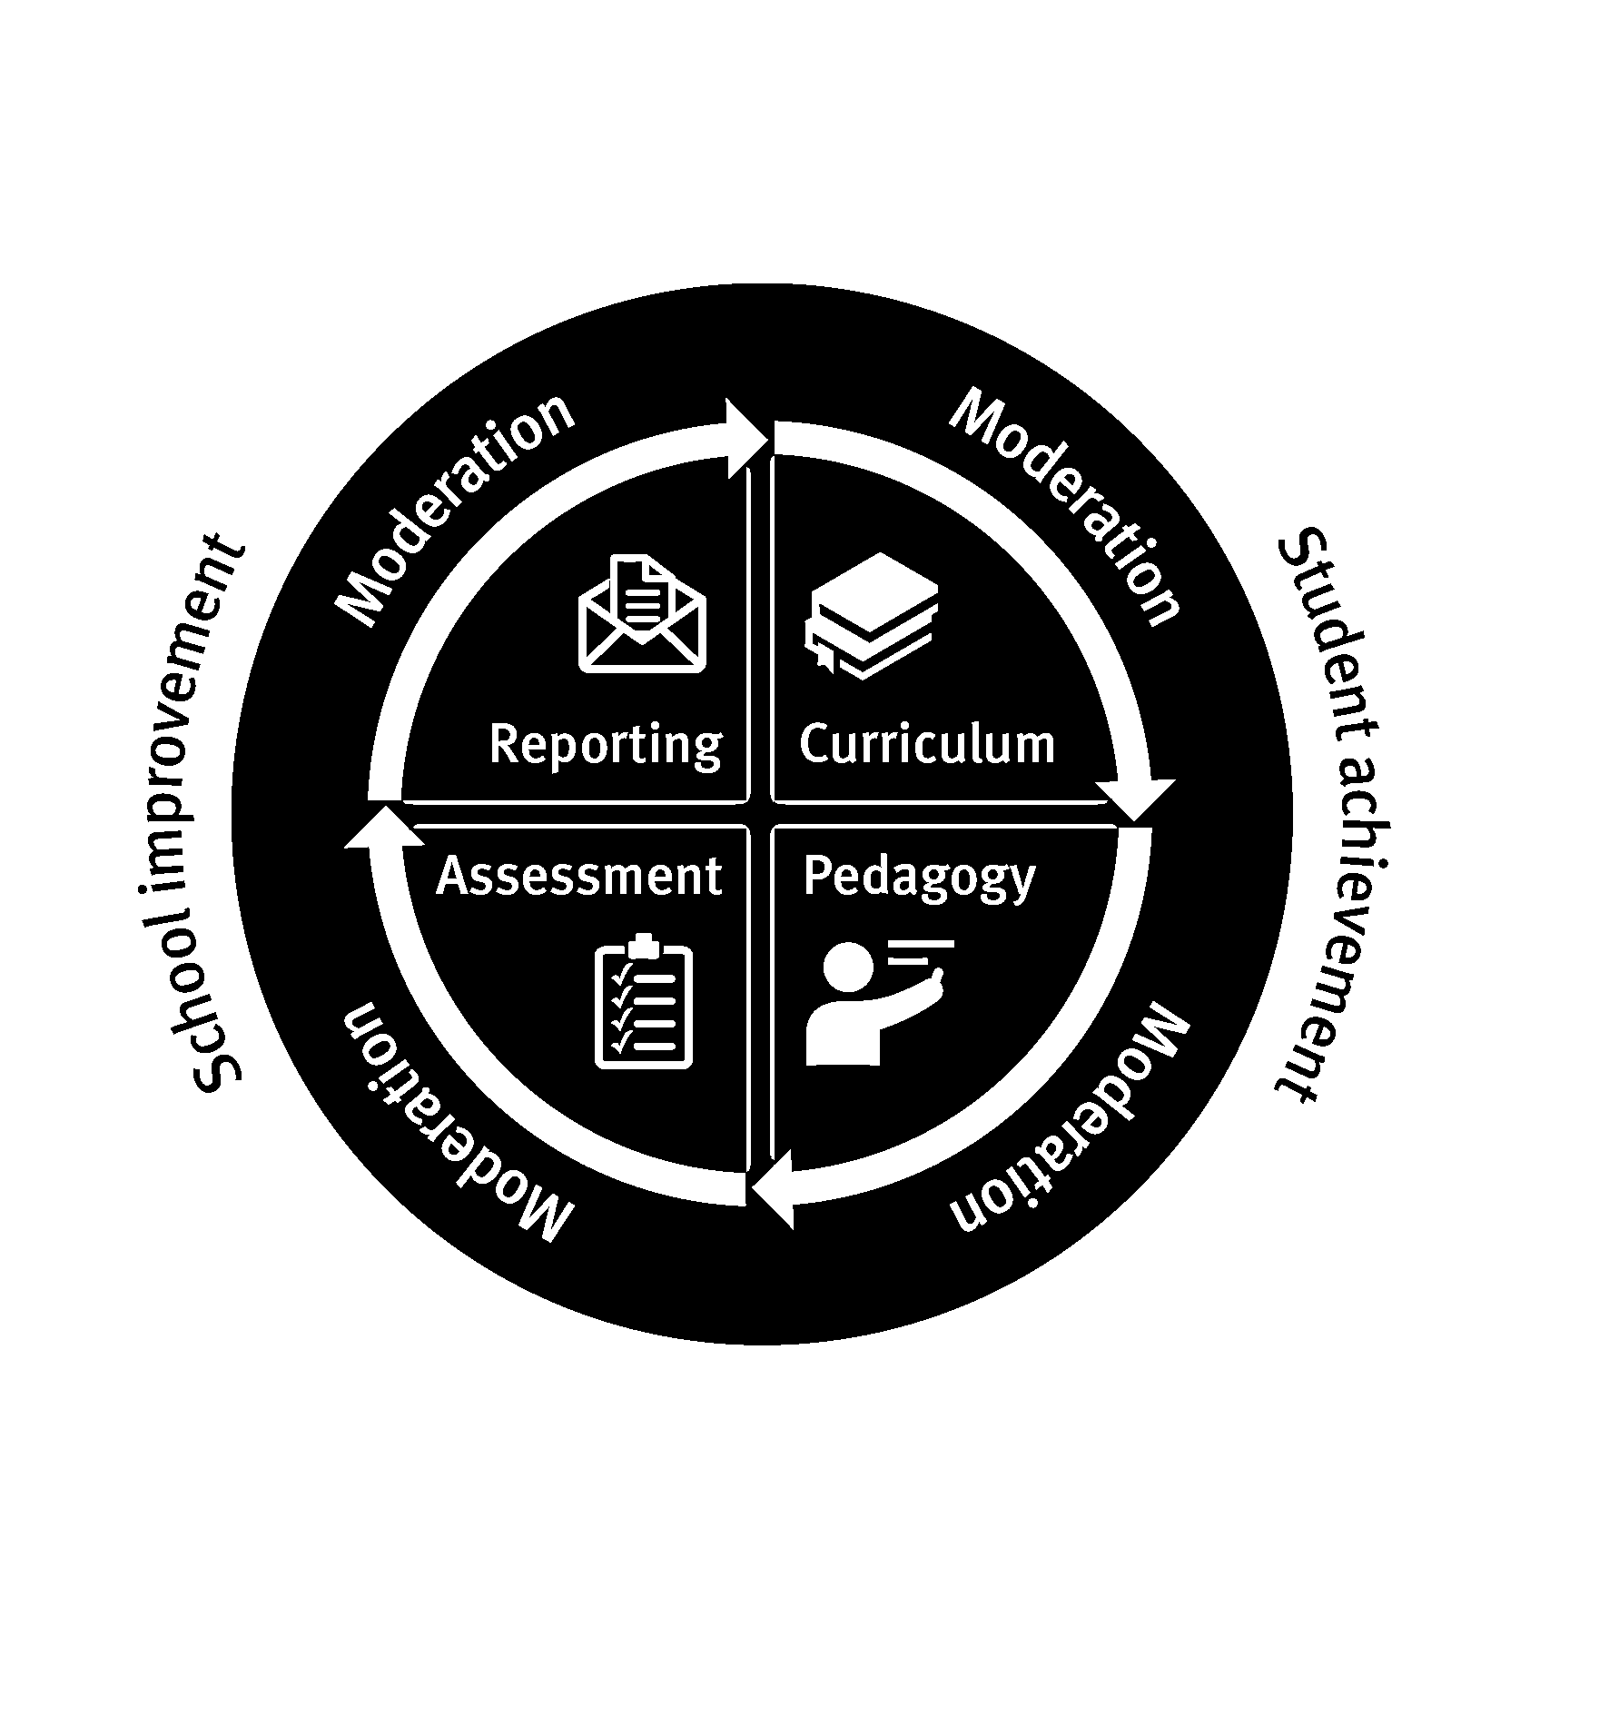





Kawana Waters State College Whole School Approach to Pedagogy
Know your Learners
Curriculum Learning Goals/ Objectives
Feedback / Reflection
Collegial Engagement
PLC / PLTs
Grading / Reporting
Instruction
Evidence Based Pedagogies
Students
Moderation
Formative Assessment/ Tracking
Summative Assessment
Signature Practices
Instruction with Intervention
Feedback

Slide 2
Analyse the data to get to Know your Learners.
Use the data to:
  Identify students who belong to target groups.
  Identify students who require additional support/extension.
  Identify and prevent possible barriers to learning.
  Identify pedagogies specific to the Learners in your classroom. (Engagement, representation, action and expression.)
  Identify focus areas and set clear goals for improvements in student learning.
Data Sources:
TrackEd ClassMats, TrackEd Reports, One School, Class Dashboard, NAPLAN, Case Managers, student surveys.
Data Types:
Assessment and reporting data including academic, effort and behaviour. Indigenous, EAL/D, PLR, Levels of support, ICP, Support provisions.
Know your Learners

Slide 3
Use Australian Curriculum and Senior Syllabus documents to identify Achievement Standards and Learning Objectives.
Unpack Learning Goals from AS (Junior), Objectives and Subject Matter (Senior).
Develop year/band plan, unit plan, assessment and marking guide.
Ensure up-to-date planning is available in Sharepoint. (Curriculum – ACV9)
Develop formative assessment (formal and informal).
Use previous data analysis along with diagnostic/pre-testing to identify entry points, appropriate pedagogies and pacing.
Plan and implement inclusive strategies to support all learners. (Engagement, representation, action and expression.)
Moderation – Before assessment takes place.
Curriculum Learning Goals/ Objectives

Slide 4
Create and maintain a safe and supportive learning environment as per college expectations.
Employ the Essential Skills for Classroom Management.
Establish and maintain entry and exit routines.
Engage in Explicit Teaching using the Gradual Release Model with a balance in teaching and learning phases.
Plan and implement inclusive teaching strategies to support all learners. (Engagement, representation, action and expression).
Unpack the assessment and marking guide.
Create regular opportunities for students to engage in Retrieval Practice.
Ongoing formative assessment (informal tracking).
Feedback cycles (Teacher, Student, Parent)
Instruction

Slide 5
Monitor student progress related to Learning Goal and/or Marking Guide.
Informal Formative Tracking.
Implement formal Formative Assessment.
Schedule PLT meeting to discuss results.
Formative Assessment/ Tracking

Slide 6
Teacher → Teacher
Engage in in PLTs and use evidence to:
Evaluate where students are at in the learning process.
Identify groups or individuals who require more focussed teaching. (Support)
Identify groups or individuals who require extension.
Identify key areas for improvement in student learning.
Identify specific pedagogies and develop interventions to target key areas for improvement.
Teacher → Student
Provide regular and timely feedback to students on their progress against Learning Goals and/or Marking Guide.
Outline next steps for learning.
Celebrate improvement/achievement.
Student → Teacher
Students use Learning Goals and/or Marking Guide to self-reflect on their learning and seek assistance.
Feedback

Slide 7
Use Formative Assessment/Tracking and/or Marking Guide to monitor learning progress.
Identify students who require reasonable adjustments and/or interventions to access learning.
Enact specific pedagogies and interventions to support individuals or groups of students.
Enact specific pedagogies and interventions to extend individuals or groups of students.
Identify students who require reasonable adjustments for upcoming summative assessment.
Instruction with Intervention

Slide 8
Implement Summative Assessment.
Implement reasonable adjustments to assessment conditions where necessary.
Moderation – After assessment takes place.
Summative Assessment

Slide 9
Feedback between Teachers and Students, Teachers and Parents.
Celebration and formal recognition.
Moderation – At the end of the reporting period.
Grading / Reporting

Slide 10
Engage in PLTs:
Analyse, reflect and feedback using Summative Assessment, Formative Assessment, Reporting Data, Unit Plans, interventions and any other collected evidence to determine pedagogical processes that were most and least effective and inform future teaching and learning.
    How do we know what is working?
    How will we use this evidence to inform next steps in teaching for continuous improvement in student engagement, learning and achievement?
Identify and refer students who require more intensive support.
Celebrate successes.
Identify future focus areas.
Moderation – At the end of the reporting period.
Feedback / Reflection

Slide 11
Teachers are active participants of:
A Professional Learning Community (P-12 PLC)
Professional Learning Teams (PLTs)
Moderation Cycles – Before, after, end.
Reflective Practices
      Instructional Rounds
      Classroom Profiling
      Peer Observations
      SPG Observations
      Learning Lounges
      T & L Health Checks
Teachers engage in:
Feedback cycles (Staff, Student, Parent)
Developing an SPG. (Setting Professional Goals)
Learning Lounges (2 x year)
Professional Conversations
Identifying and accessing targeted Professional Development
Collegial Engagement

Slide 12
-
KWSC is a Professional Learning Community (PLC) which consists of many Professional Learning Teams (PLTs). Teachers are active members of PLTs and use the questions below at various stages of the Teaching and Learning cycle.
PLC/PLTs Questions
Q1. Who are our students and how do they learn?
Q2. What do we want students to know and do?
Q3. How will we know if students are learning?
Q4. How will we respond if students are not learning?
Q5. How will we enrich and extend the learning of students who are already proficient?
Q6. How will we increase our instructional competence?
PLT questions are aligned to the phases within the Whole School Approach to Pedagogy.
PLC / PLTs

Slide 13
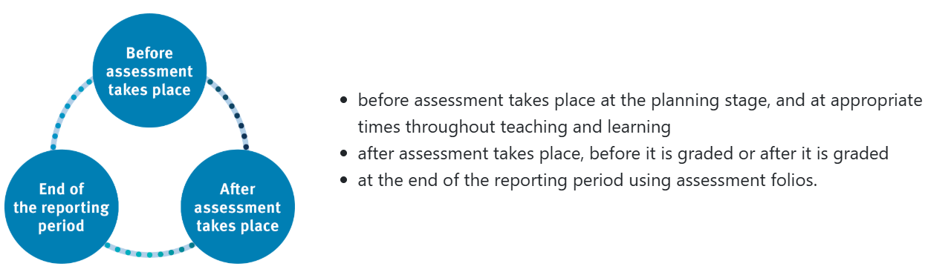
KWSC uses the Before, After, End Model for Moderation to align curriculum, pedagogy, assessment and reporting; and to ensure consistent judgments and accurate reporting against the achievement standards. Moderation takes place in the follow stages of the Teaching and Learning Cycle:
Moderation

Slide 14
Whole School Approach to Pedagogy.
KWSC Daily Lesson Structure.
Explicit Teaching using Gradual Release Model.
Learning Walks and Talks.
2026 Focus Areas:
Enacting Whole School Approach to Reading. (Primary)
Developing Whole School Approach to Moderation – Refining Assessment Package.
Developing Whole School Approach to Differentiation.
Defining and promoting Balanced Digital Learning.
Strengthen Science of Learning practices.
Signature Practices

Slide 15
Essential Skills for Classroom Management.
Pedagogical Practices for Learning. (DET)
Digital Learning Hub. (EQ)
Science of Learning.
Science of Reading.
Universal Design for Learning. (Engagement, Representation and Expression.)
-
Evidence Based Pedagogies

Slide 16
